Slide 1
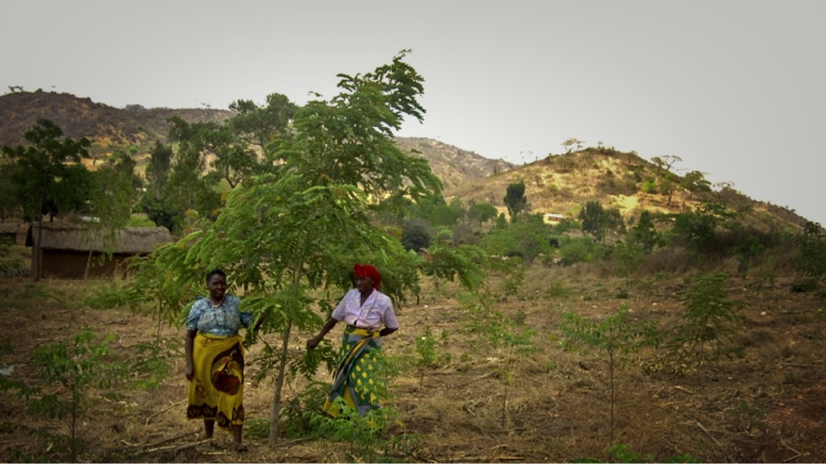



TIST
The International Small group Tree planting programme
Accelerating growth of a successful
pro-poor carbon offsetting small group tree planting programme in Africa
Enterprise for Development (EfD) working in partnership with CAAC/ TIST

Slide 2
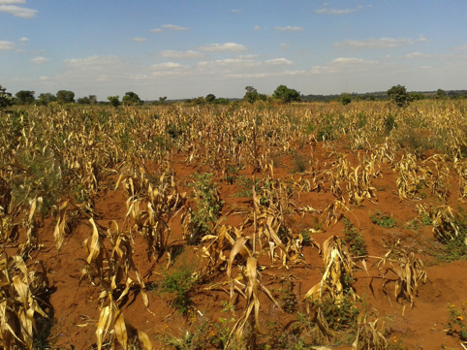
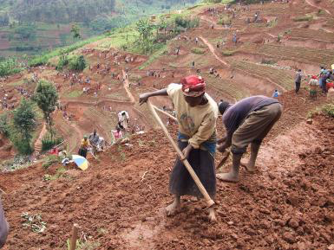
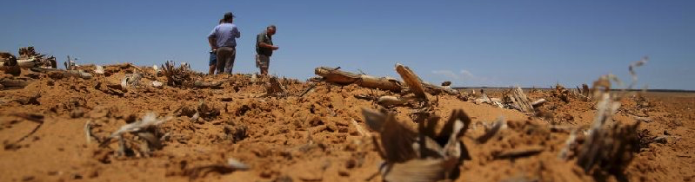
Responding effectively to the climate change challenge
Tree planting is one of the simplest and most cost effective means of mitigating climate change, by absorbing CO₂ from the atmosphere
Tree planting on degraded land absorbs carbon from the atmosphere and generates significant improvements to the livelihoods of smallholder farmers
TIST supports tree planting on degraded/unused land in low income countries by and for the benefit of smallholder farmers
Restoring existing degraded land is a highly effective climate change opportunity
2
Notes:
IPCC figures estimate that most of the mitigation potential of industry emissions (such as fuel switching or CCS) will be available at $50-200/tCO2, and that some mitigation options in the transport sector (especially HGVs and aviation) may have costs ranging from $0-400/tCO2.
Some Negative Emissions Technologies (NETs; i.e. those that remove CO2 from the atmosphere) can be cost competitive with mitigation options at scale – some studies show abatement costs of US$60-160/tCO2.
TIST estimates suggest that programme costs will amount to $4.50/tCO2.
Sources:
McGlashan, N., Shah, N., Caldecott, B., Workman, M. 2012 “High-level techno-economic assessment of negative emissions technologies,” Process Safety and Environmental Protection, 90(6), 501–510.
http://www.smithschool.ox.ac.uk/research-programmes/stranded-assets/Stranded%20Carbon%20Assets%20and%20NETs%20-%2006.02.15.pdf
IPCC, 2014. Climate Change 2014: Mitigation of Climate Change. Contribution of Working Group III to the Fifth Assessment Report of the Intergovernmental Panel on Climate Change. Cambridge University Press, Cambridge, UK and New York, NY, USA.
Carbon emission stat source: https://www.co2.earth/global-co2-emissions
https://www.google.co.uk/url?sa=t&rct=j&q=&esrc=s&source=web&cd=2&ved=0ahUKEwjf0bbNhP3OAhUqD8AKHbFdAaYQFggnMAE&url=https%3A%2F%2Fdialnet.unirioja.es%2Fdescarga%2Farticulo%2F4997468.pdf&usg=AFQjCNGTYCsiRwCvCsHsS5zIX9Q3VDA09A

Slide 3
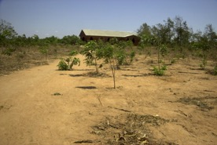
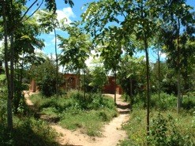
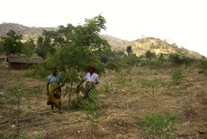
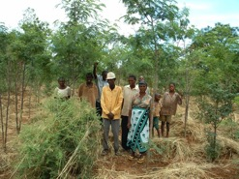
What does TIST do?
TIST encourages small groups of smallholder farmers to improve their farms by planting and maintaining trees on degraded and/or unused land
Already, >93,000 members in 4 countries have planted >19 million trees and captured >5.6 million tonnes of carbon to date, and will capture an additional 13?? million tonnes
As the trees grow, carbon captured is quantified and verified and certified greenhouse gas credits are sold in the global carbon market
TIST pays the smallholder farmers small annual payments per tree established and 70% of the net profit received when credits are sold
Smallholder farmers also derive significant non-carbon related benefits (described later)
Tree planting has a positive environmental impact
Before After
Before After
3

Slide 4
TIST Values
TIST Values - honesty, accuracy, transparency, mutual accountability, service to one another, and small budget/big results - formally articulated and consistently applied.
True gender equality – not just share of women and men involved (it is 50/50) but also about shared governance responsibilities – one man/one woman at every level of the organisation (small group, cluster, Council).
Genuine mutual accountability – leadership of each tier of the governance structure (small group, cluster etc.) fully accountable to its members and selected/reselected on an annual basis.

Slide 5
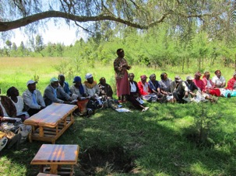
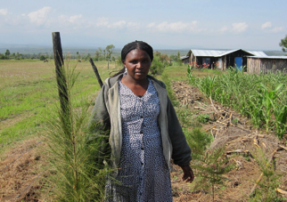
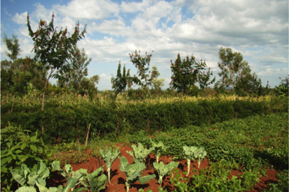
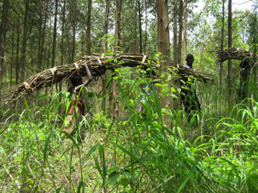
The small group tree planting programme
Farmers are mobilised by other TIST farmers and join small groups of 6-12 people that form clusters of up to 500 local farmers. Clusters act as a mechanism to organise the small groups of women and men
Farmers decide whether, where and how to plant trees, source and own the seeds and keep ownership of the trees and land
Trees are typically planted on degraded and/or unused land (e.g. around houses for shade, in small wood lots for firewood, along boundaries as windbreaks, along streams for flood and soil control)
Participants are contracted to maintain the tree groves for 60 years in return for small annual payments per tree planted, and entitlement to a share of the net profit from carbon credit sales. Significant non-carbon benefits are also realised in the form of farm improvements
After 5 years of tree growth, tree mass and the volume of carbon stored in the trees can be calculated, the carbon captured is verified to international standards, and carbon credits can be offered for sale
Carbon credits do not have to be monetised immediately, but can be retained and sold at a later date
5

Slide 6
Verifying the carbon reductions
TIST is the world's first dually validated and verified carbon offsetting programme (by VCS (Verified Carbon Standard) and CCB (Climate, Community and Biodiversity Standards)).
Voted Best Offsetting Project 2013 and 2015 (runner-up in 2014) and Best Project Developer (forestry and land use) 2015 (Environmental Finance)
TIST is recognised as a leading carbon offsetting programme and has developed an award-winning monitoring system, using third-party verified standards to ensure carbon emission reductions are real and additional
TIST has sold carbon offsets to a number of large and multinational corporations through resellers and bilateral agreements with end-purchasers
  Purchasers have included BP, DHL, Freshfields, Grundon, Hyundai, Marks & Spencer, Microsoft, Tata, Delta Airlines, Taylors Tea
Strong verification mechanisms and the demonstrably pro-poor nature of the programme enables TIST to market and sell the carbon credits at significant premium over the voluntary offset market price
6

Slide 7
The value of carbon credits
Average market prices paid for carbon credits
Companies, governments and individuals purchased 84 MtCO2e in forest-based emissions reductions through voluntary carbon markets in 2015, at a total value of $278m (Update)
  The voluntary market price for carbon is weak ($3.30 in 2014; avg of $4.60 between 2007 and 2014) due to the marketplace and a lack of policy consistency
  TIST has been able to consistently sell credits at premium prices ($7.2 in 2014), in line with other tree planting voluntary offsets
  The value to the global community is much higher than the market price (World Bank estimate $30)
Analysts forecast much higher carbon market prices following COP21 and Market Stability Reserve agreements (EU ETS prices are forecast to rise to $40 by 2028), with voluntary market prices tracking mandatory market prices
TIST is sustainable and generates significant small farmer benefits even at current low carbon prices
7

Slide 8

TIST carbon and non-carbon benefits for small farmers
Carbon advance payment
A payment of $0.03 is made per tree per year
Carbon credit sale
70% of net profits from carbon credit sales are returned to farmers
Woodlot
Wood from deadfall and integrated management used for firewood and compost manure
Forestry
Other benefits accrue from the sale of seedlings and production of fruit, nuts, fodder
Fuel
Reduced fuel costs for cooking and heating stoves
Conservation farming
Benefits accrue from improved soil fertility and crop yields
Carbon related benefits
Non-carbon related benefits
Although the upfront carbon payments are small it is clear that large numbers of poor small farmers have volunteered to plant large numbers of trees at their own cost because they value the short term non-carbon benefits as well as the potential for a share of deferred carbon payments
Pro-poor benefits independently evaluated “TIST provides exceptional community benefits to their members…[and] women receive 92% of the average benefits”
Average benefit over the programme life cycle estimated at $140-170 p.a., depending on the carbon price, of which at least 50% are non-carbon benefits
Given that the vast majority (circa 85%) of TIST participants earn less than $2 a day, these benefits represent a significant boost to their incomes
The benefits to the global community are much greater than this, because the social value of absorbing carbon from the atmosphere is likely to remain much higher that the market price
8
Notes:
Source for smallholder income stats: http://www.fao.org/3/a-i5251e.pdf

Slide 9
TIST governance
TIST was established by Clean Air Action Corporation (CAAC), a US pollution reduction, climate change mitigation and adaptation company
The Institute for Environmental Innovation (I4EI), a 501(c)3 US public charity, provides a mechanism for US taxpayers to make tax-deductible donations to TIST, and donors to provide grant finance
CAAC provides the operational management through local offices and local farmers, with proven success records
Payments to the TIST small groups are made as per the signed contract, often using a mobile money transfer (e.g. mPESA)
Payment amount is based on quantified tree stock held by the group. Each small group determines the group’s use of funds and/or disbursement to individual farmers
9

Slide 10
TIST costs
  TIST has proven it can operate sustainably even at very low carbon market prices because it's costs are very low
The farmers themselves acquire seeds, plant the seedlings and maintain the trees. The up front cost to CAAC is in the mobilisation, training and facilitation of the small groups, initial verification costs, and the annual payment of 2 cents per tree to the small groups when the trees are established
CAAC costs are limited to international and country office staff (salary and travel), administrative and technology support, group facilitation, verification and certification, and marketing and credit sale costs
Consequently, over the period 2012 to 2046 when TIST will already expand from 12m to 28m trees and capture an additional 10m tCO2e, CAAC’s costs are estimated to amount to $2.05/tCO2e absorbed, and $2.48/tree planted
TIST’s costs, farmer returns and net profits are broken down as follows, assuming a sale price of $10 per tCO2e
10

Slide 11
What is special about TIST?
Self-reliance and ownership
Small farmers participate voluntarily because they see and value the benefits, and are willing to incur effort and costs upfront despite the small front-end payments. They also retain ownership of the improved properties throughout
Pro-poor benefits
TIST participants are paid a small advance on the carbon stored in their trees, and receive 70% of net profits from carbon credit sales, alongside significant additional non-carbon benefits. If the carbon market rises (as is widely expected), the benefits to the small farmers increase as the cost per tonne of carbon produced remains the same
Environmentally and climate friendly
Large environmental benefits are accrued through improved biodiversity and soil quality, as well as much greater social benefits of carbon absorption than are priced into the carbon credits
Sustainable and low cost
TIST is financially sustainable even at the current low carbon price, primarily because TIST’s costs are low as small farmers are trained so that they can acquire and plant the trees at their own cost
Successful and award winning
TIST is not a greenfield project, it is a demonstrable success - over 75,000 members in 4 countries have planted over 16 million trees demonstrating enthusiastic participation by small farmers. TIST's model has been widely recognised and acclaimed
Scalable
The programme is highly scalable, hence the expansion project described here
11

Slide 12
Expanding TIST – the proposition
Investment need
$11m
$11m is being sought between 2016 and 2020 to scale up the TIST programme, resulting in:
    The engagement of 67,000 additional programme participants, formed in 160 clusters in present countries and adjacent expansion*
    15m additional trees being planted over 32,000 hectares, to capture an additional 16m tCO₂e over a 30 year period
This is not a greenfield venture, but rather builds on an existing successful programme
Additional carbon offsets created will account for a small proportion of the voluntary market for tree planting offsets, and are not expected to affect prices
An average programme participant will plant 195 trees and is expected to receive:
  An annual pre-payment per tree of $0.03 for 20 years, equating to $117 in total
  Carbon payments (depending on the carbon price realised) of between $900 (at $7 per tCO2e) and $5,500 (at $30 per tCO2e) over 30 years
  Estimated non-carbon benefits of $3,540 over 30 years
Social benefits from GHG reductions equate to $470m, at $30 per tCO2e
Programme participants
67,000
Trees
planted
tCO₂e captured
15m
16m
12
* There is some degree of flexibility in the selection of sites, and other countries may be considered

Slide 13
Expanding TIST – the business model
The existing TIST business model will remain unchanged but strengthening of governance and operational capacity is planned in some areas
CAAC’s costs will amount to $3.17/tCO2e absorbed, and $4.20/tree planted
Projections assume a small carbon price increase to $10 per tCO2e over monetisation period, offering a sustainable and profitable business model and significant additional benefits for small farmers if carbon prices increase further (as projected)
The model is however sustainable even at current low carbon market prices
Between 2017 and 2046, at a market price of $10 per tCO2e, CAAC will generate:
  A net cash gain in excess of $80m
  Aggregate carbon benefits to farmers of $245m
  Aggregate non-carbon benefits to farmers of $500m
  Social benefits in excess of $1.2bn
13
Notes:
NOTE: The TIST expansion will result in an additional 11m tCO2e being sequestered over a 30 year period. At current market levels, this would account for a small percentage of the voluntary offset market, and is expected to account for an even smaller proportion of the market, as the market grows over time. As such, there is a very limited risk of the expansion affecting the market price for voluntary carbon offsets.

Slide 14
Expansion of the TIST structure
IE4I
(US 501c3)
NewCo
(not-for-profit charity)
A new company limited by guarantee with charitable status (NewCo) is proposed
NewCo will be accountable to funders via contracts with CAAC for the agreed scope of work
CAAC will be accountable to funders via NewCo, and to farmers through contracted arrangements in line with existing TIST processes
CAAC
CAAC
Kenya Branch
CAAC Tanzania UMET
CAAC
Uganda Branch
Smallholder farmers
Non-US funding will be channelled to CAAC via NewCo subject to contract for TIST programme expansion
Relationship between CAAC and small farmers will be the same as the existing TIST programme
14

Slide 15
Funding the expansion
Type of funding | Pros and cons
Grant funding | Demonstrates immediate support for pro-poor climate-sensitive programme Maximises benefits to small farmers (through increased net profits shared with them) Increases reinvestment funds available to further grow TIST
Pre-purchase of carbon credits (in effect 0% loans repayable when carbon credits monetised) | Demonstrates immediate support for pro-poor climate-sensitive programme May reduce benefits to small farmers if pre-purchase price is below potential future net price
Long term (10-12 yrs) low interest (3-5%) loans | Demonstrates immediate support for pro-poor climate-sensitive programme Reduction in benefits to small farmers (as net profits shared with farmers are net of interest and principal repayments) Reduction in funds available for reinvestment to further grow TIST
15

Slide 16
Key risks and risk management
Type of funding | Risk assessment | Risk management
Small farmer performance | Low/Medium | Existing TIST programme history demonstrates good farmer performance planting and maintaining trees
Cost control | Low | Most of famer costs are incurred themselves TIST incremental costs are low and managed
CAAC performance risk | Low/Medium | High key persons risk to be mitigated by hiring younger expertise in-house
Validation/ monetisation of credits | Low | TIST has demonstrated excellence in this area
Carbon credit price risk | Medium/High | Carbon market price risk is high but base case is sustainable even at the current low price. Price risk can be mitigated through funding options outlined earlier.
16

Slide 17
Who and why to support TIST...
TIST offers a sustainable and scalable model to improve the livelihoods of subsistence farmers, while improving biodiversity and reversing the effects of deforestation
Who supports TIST Why support TIST
Investment
Increased incomes means farmers can invest in improved inputs
Consumer businesses
Producer businesses
Financial services businesses
Professional services businesses
Social investment funds
Philanthropists
Soil quality
Improving soil quality can lead to improved farmer productivity
Drought and flood resilience
Trees reduce air and soil temperature, and soil moisture loss. Trees also protect crops from heavy rains and reduce soil being washed away
Water
Trees provide a natural water filtration process and improve water quality
Biodiversity
Tree groves create a local microclimate by providing buffers, corridors and stepping-stones in the landscape
17

Slide 18
Additional information 1
Small group tree planting programme governance
TIST’s success is based on country leadership. Farmers are introduced to TIST by other TIST farmers and organised into small groups of 6-12 people that form a cluster of up to 500 local farmers with elected leadership positions that include women and men
The cluster meets monthly, and acts as a platform for networking, trading and sharing experiences among peers, as well as a mechanism to distribute information/materials to programme participants and collect tree data for calculating carbon
CAAC enters into a contract with each small group to maintain the tree groves for 60 years in return for the agreed carbon benefits, and associated non-carbon benefits. CAAC is contracted to provide the programme structures, provide programme updates to participants, and undertake trainings, monitoring and marketing of credits
CAAC disburses funds to the small groups, as per signed contract, often using a mobile money transfer (e.g. mPESA)
Payment amount is based on quantified tree stock held by the group and profit sharing
Small groups oversee group use of funds, and/ or disbursement to individual farmers
18

Slide 19
Additional information 2
Process of verification
TIST’s award-winning monitoring system and 3rd party verified standards involve:
Marketing of the carbon credits
TIST has sold carbon offsets to a number of large and multinational corporations, and through negotiations with end-purchasers and brokers
TIST’s clients have included Apollo Tyres, BP, DHL, Freshfields, Grundon, Hyundai, Marks & Spencer, Microsoft and Tata
Feasibility assessment
An assessment of project assumptions, feasibility and risks is conducted
Brokers and resellers
TIST has sold the majority of carbon offsets through a respected reseller, Natural Capital Partners
Baseline assessment & validation
Trained quantifiers record baseline data and measure existing tree mass
End buyer sales
Quantification
TIST has also managed the sale of carbon offsets to end buyers directly
Current tree mass data is used to calculate CO₂ stored in the trees annually. This translates into a carbon value (less any credits previously claimed on the tree)
Pre-payment agreements
Eight private sector corporations have entered into long-term pre-payment agreements for future carbon credits
Verification
After project implementation and monitoring, a separate 3rd party auditor assesses the delivery of GHG mitigation
Eligible offsets offered for sale
Offset project registries issue each tonne of emissions reduction under a unique code that can be transacted
19

Slide 20
Additional information 3
Market for forestry carbon credits
Companies, governments and individuals purchased 84 MtCO₂e in forest-based emissions reductions through voluntary carbon markets in 2015, at a value of $278m
While market value increased over 2014, the average price per tCO₂e declined to $3.30
The avg price per tCO₂e between 2007-14 was $4.60
The social value per tCO₂e is significantly higher (~$30)
There is however significant optimism on future demand for voluntary offsets following:
  The landmark COP21 agreement to reduce GHG emissions
  Agreement on the Market Stability Reserve to remove surplus emission allowances from EU ETS
  The inclusion of climate change into the UN's SDGs
  Analysts predict voluntary market prices will track mandatory market prices, such as the EU ETS, where prices are forecasted to rise to $40 by 2028
20
Notes:
The estimated value to the global community is much higher than the market price (World Bank estimate $30).
Analysts forecast much higher carbon market prices following COP21 and Market Stability Reserve agreements, with voluntary market prices tracking mandatory market prices (EU ETS prices are forecasted to rise to $40 by 2028)

Slide 21
Additional information 4
Expected benefits to programme participants
Independent reports “highlight how TIST provides exceptional community benefits [and has a] highly positive net benefit to the participants and community”
Results show that “vulnerable households experienced a range of benefits from sales and savings. Notably, incremental livestock and their products and harvesting tree products such as fruit, nuts, fodder and firewood …. with the new survey showing it [has a] higher value than the cash payments”
“The Yale/NEC Survey showed that women receive 92% of the average benefits…and attended more cluster meetings and received more training than men”
* Data and quotes excerpted from the Project Implementation Report prepared and verified for the Climate, Community and Biodiversity Standard gold level survey. The original survey was done in 2011. The Yale/New England College (NEC) survey was conducted in 2015.
21

Slide 22
Additional information 4
Expected benefits to programme participants
An average programme participant will plant 195 trees and is expected to receive:
An annual pre-payment per tree of $0.03 for 20 years, equating to $117 in total
  A cumulative carbon payment (depending on the carbon price realised) of between $900 (at $7 per tCO2e) and $5,500 (at $30 per tCO2e)*
  Total cumulative other non-carbon benefits equating to $3,540**. This includes:
    Woodlot from from deadfall and integrated management used for firewood and compost manure ($1,778)
    Forestry, including from the sale/consumption of seedlings and production of fruit, nuts and fodder ($191)
    Reduced stove fuel costs ($1,176)
    Conservation farming in terms of impro-ved soil fertility and crop yields ($395)
This equates to an average annual benefit of over $170 per programme participant
* Chart depicts a constant carbon price realised of $10 per tCO2e
** Based on independent evidence from TIST programme
22

Slide 23
Additional information 5
Terms of agreement between CAAC and small groups
CAAC enters into a contract with each small group to maintain the tree groves for 60 years in return for the agreed carbon benefits, and associated non-carbon benefits
The participants and/or small group own the land (or have rights to plant trees), the trees, and the fruits, nuts, medicines and all other products from the trees and any crops from sustainable agriculture practices
The small groups agree to plant a minimum number of trees per year for at least 5 years; raise the trees to maturity; and replant trees that die, for any reason, each year for the next 20 years
CAAC agrees to provide the programme structures, provide programme updates to participants, and undertake trainings, monitoring and marketing of carbon credits
CAAC pay the small group 70% of the net value of the GhG credits made by the small group annually.* For the first 20 years of the contract, CAAC pre-pays the small group $0.03 per year for each live tree
The remaining 30% of the net value of the GhG credits is retained by CAAC to cover other business costs (e.g. for expansion to other sites) and may be used for other corporate purposes
* The payment is based on cumulative revenues, less direct costs associated with program operations (e.g. administration, quantification, verification, marketing of credits)
23

Slide 24
Additional information 6
CAAC historical financial performance
CAAC turned profitable in 2014, posting profits of $123,000 in 2014 and $218,000 in 2015
Since 2011, TIST has sold 0.8m tCO₂ at a value of $5m, and an average value of $6.5 per tCO₂. 2016 sales so far are <60,000 tCO₂
CAAC has been financed by shareholder equity and grants to date
It has no long term liabilities; current liabilities of ~$400k are to related parties with no defined payment date
CAAC’s net assets of $1.7m comprise carbon-related assets, including verified carbon credits ($0.5m) and work in progress (WIP) credits which have yet to be validated ($0.7m)
24

Slide 25
Additional information 7
TIST expansion forecasted financial performance
Expected business performance, excluding any loan repayments and profit share returns to CAAC and programme participants
Between 2017 and 2046, at a market price of $10 per tCO₂e, an $11m investment* will support CAAC to:
  Generate a net cash gain in excess of $80m
  Return $245m in carbon benefits to farmers
  Lead to non-carbon benefits of $500m
  Generate additional social benefits in excess of $1.2bn
Data on carbon credit revenue to 2026 is based on TIST’s actual experience of CO₂ sequestered to date. Data from 2027 onwards is based on conservative estimates of future CO₂ sequestration rates.
* Assumes a 3% loan is provided between 2017 and 2022,
with a 15 year tenor
25

Slide 26
THANK YOU
Contact details
Keith Palmer
Email: keith@keithpalmer.org
Phone: +44 (0) 20 7539 2660
Ben and Vannesa Henneke Charlie Williams
Email: benhenneke@cleanairaction.com charliewilliams@cleanairaction.com
Phone: +1 (0) 918 747-8770 +1 (0) 918 747-8770

